Slide 1
PREMIER LEAGUE ANALYSIS FROM SEASON (2000/2001) TO SEASON (2017/2018)

Slide 2
Overview
This Power BI project provides a comprehensive analysis of football match data from the 2000/2001 season to the 2017/2018 season. The dashboards include statistics on team performance, goals scored and conceded, wins, losses, draws, streaks, and head-to-head comparisons between teams. The project uses interactive slicers to filter data by season or team, enabling dynamic insights. The data was processed and cleaned in Excel, transformed and loaded into SQL Server using SSIS for ETL processes, and structured into a data warehouse with fact and dimension tables. SSAS was used to create measures and dimensions for OLAP analysis, which are consumed in Power BI to build interactive and insightful dashboards.

Slide 3
Tools Used :
- Excel → Data cleaning and preparation.
- SQL Server → Data storage and querying.
- SSIS (SQL Server Integration Services) → ETL (Extract, Transform, Load) process.
- SSAS (SQL Server Analysis Services) → Building cubes, measures, and dimensions for OLAP.
- Power BI → Data visualization and interactive dashboards.

Slide 4
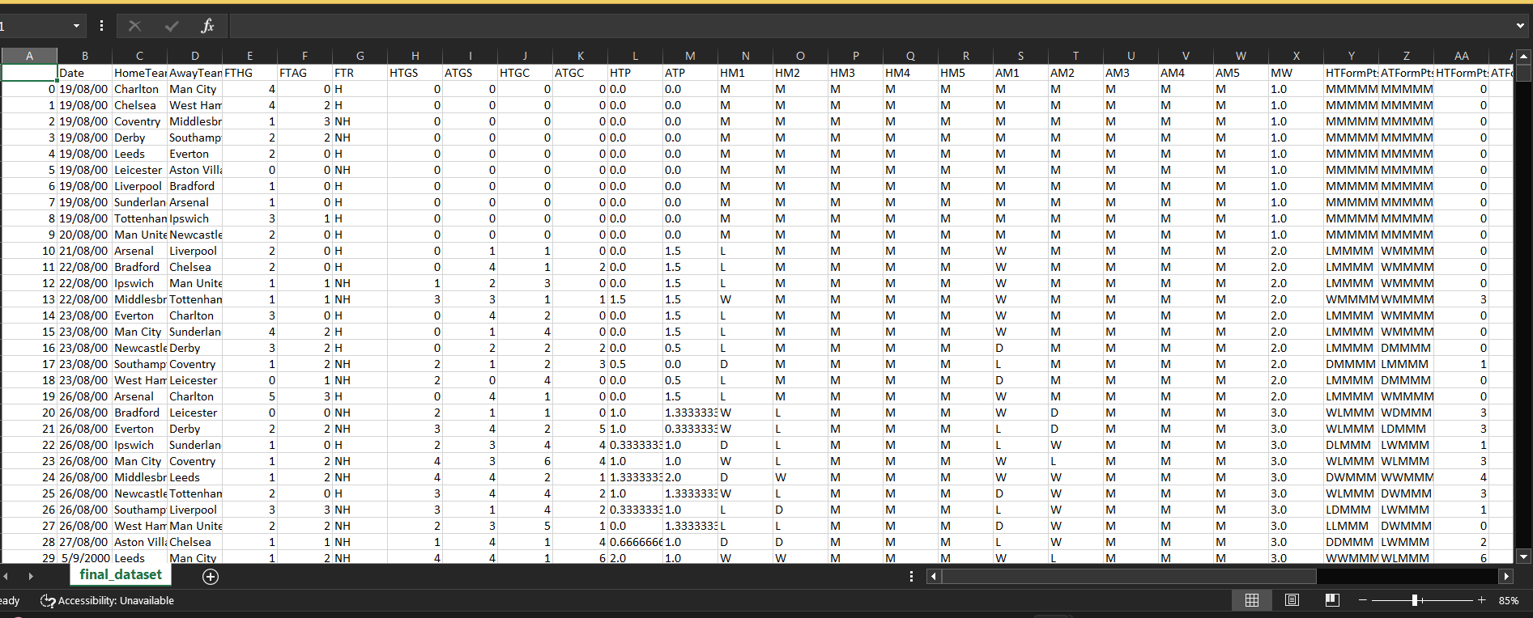
Get Data Set From Kaggle

Slide 5
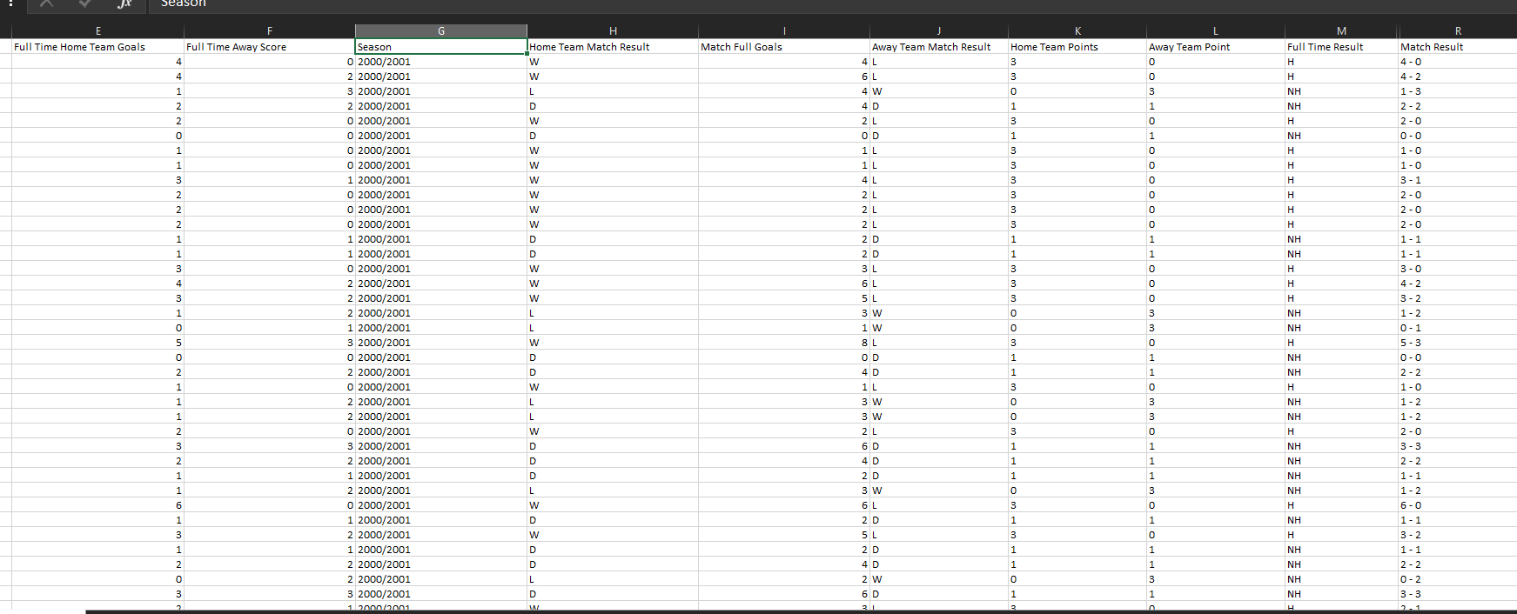
I cleaned and edited the data in Excel, correcting errors in the date column and adding new fields to support the analysis. In total, I added 10 additional columns: Full Time Home Team Goals, Full Time Away Team Goals, Season, Home Team Match Result, Match Full Goals, Away Team Match Result, Home Team Points, Away Team Points, Full Time Result, and Match Result.

Slide 6
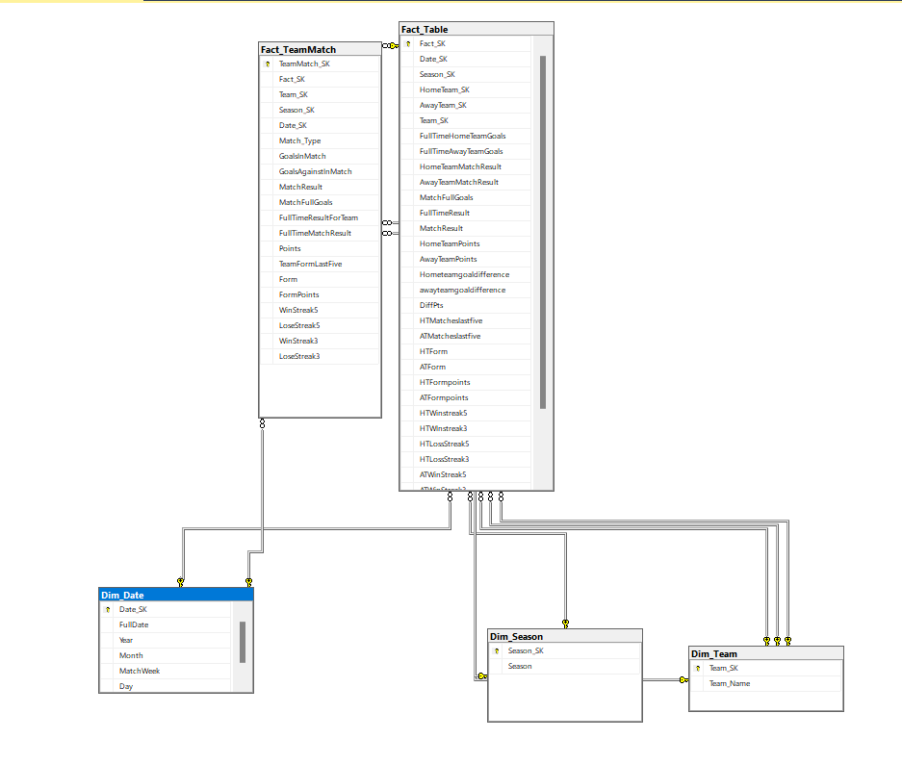
Building my Data Warehouse, the diagram shows that I created two fact tables: one for team matches (home and away) and another for all matches regardless of home or away. The HomeTeam_SK and AwayTeam_SK in the Fact_Table act as foreign keys referencing the Dim_Team table

Slide 7
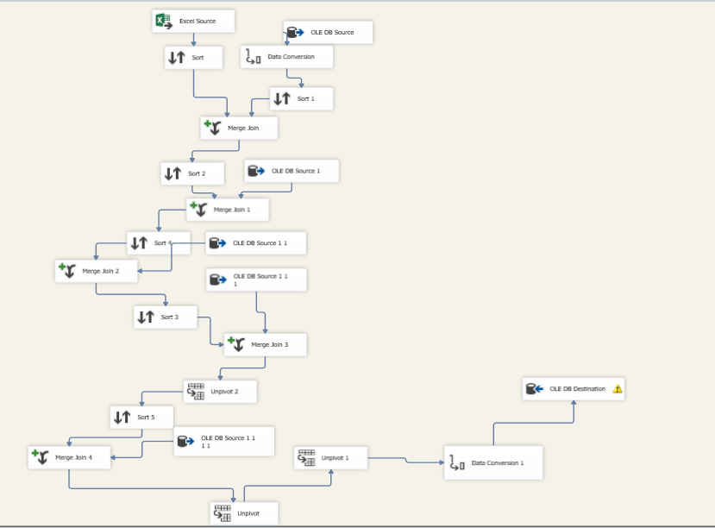
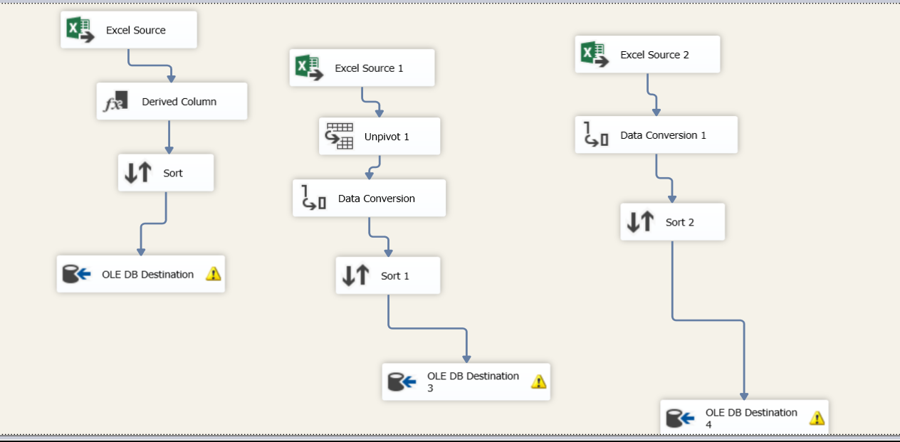
Using SSIS to create an ETL process to SQL Server

Slide 8
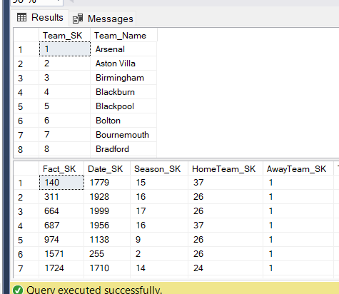
In the home team and away team data, I created one dimension called Dim_Team that contains all team names. I used HomeTeam_SK and AwayTeam_SK, and in SSIS I performed a merge join: once to match the home team name from Excel with Dim_Team, and another time to match the away team.

Slide 9
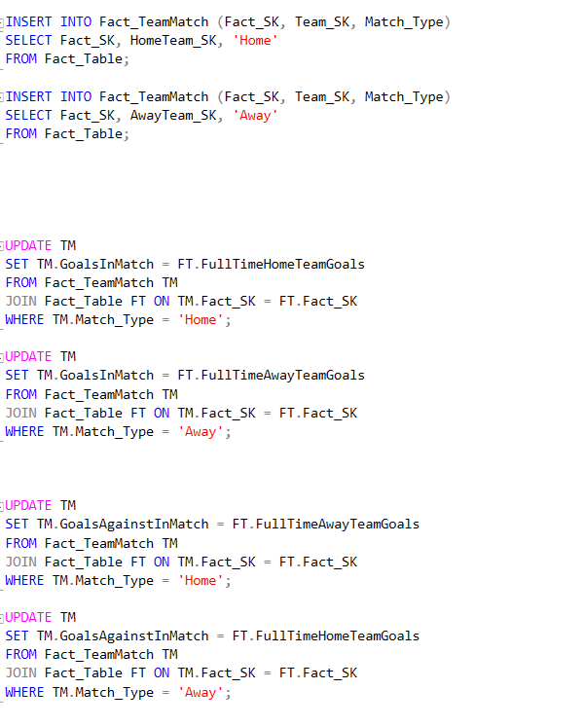
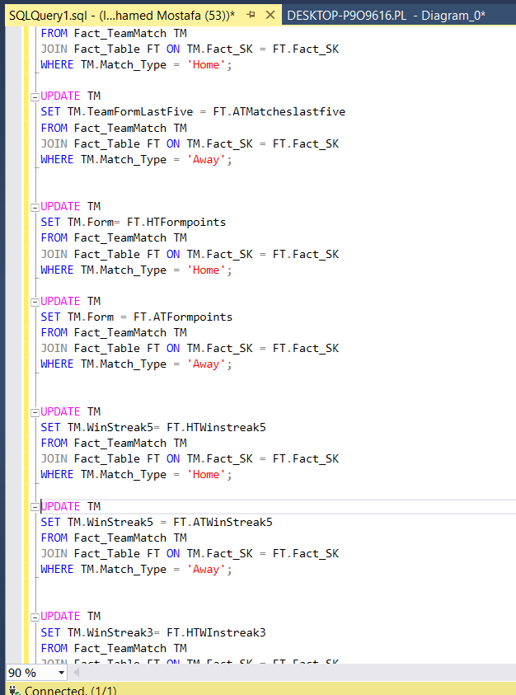
In the Fact_TeamMatches table, which displays all matches in a season regardless of home or away, I loaded data from the Fact_Table using Fact_SK and Team_SK along with their types, and combined them into one column using an SQL query. I preferred loading it with SQL queries instead of SSIS or Power BI, because this gives me more flexibility to validate the data and also helps me practice writing SQL queries. Therefore, I loaded all columns in that table using SQL.

Slide 10
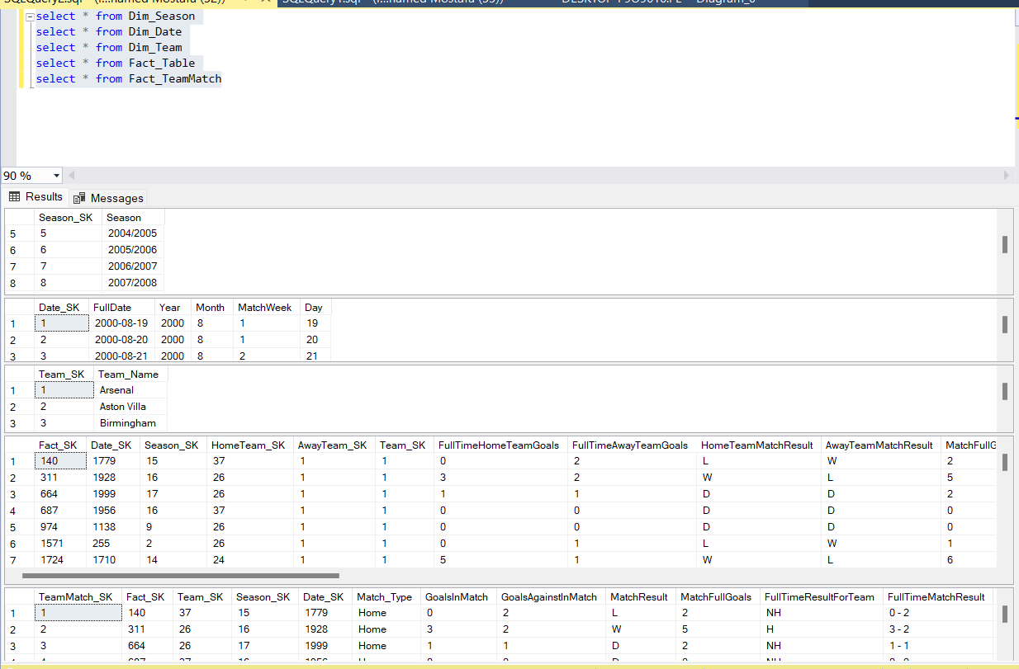
Now My DW Is Ready To Analysis

Slide 11
I make analysis by Power Bi Desktop and SSAS

Slide 12
In power pi I make three dashboards

Slide 13
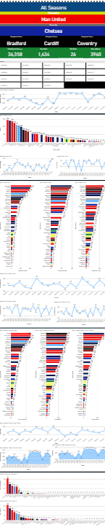
Dashboard 1

Slide 14
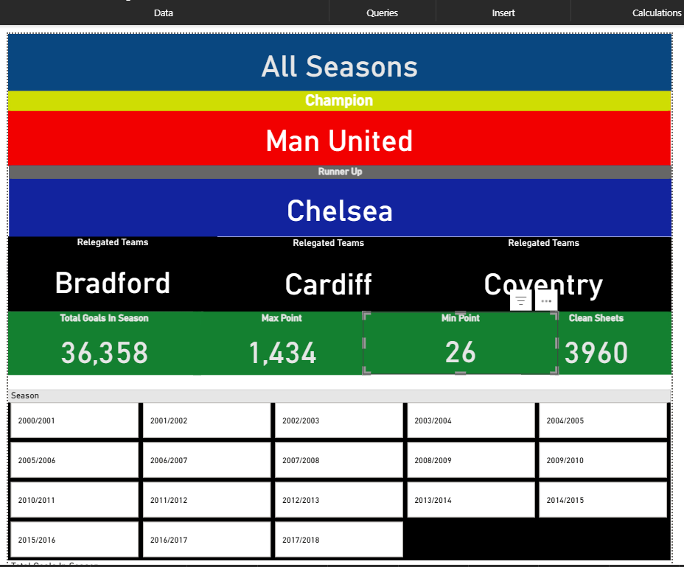
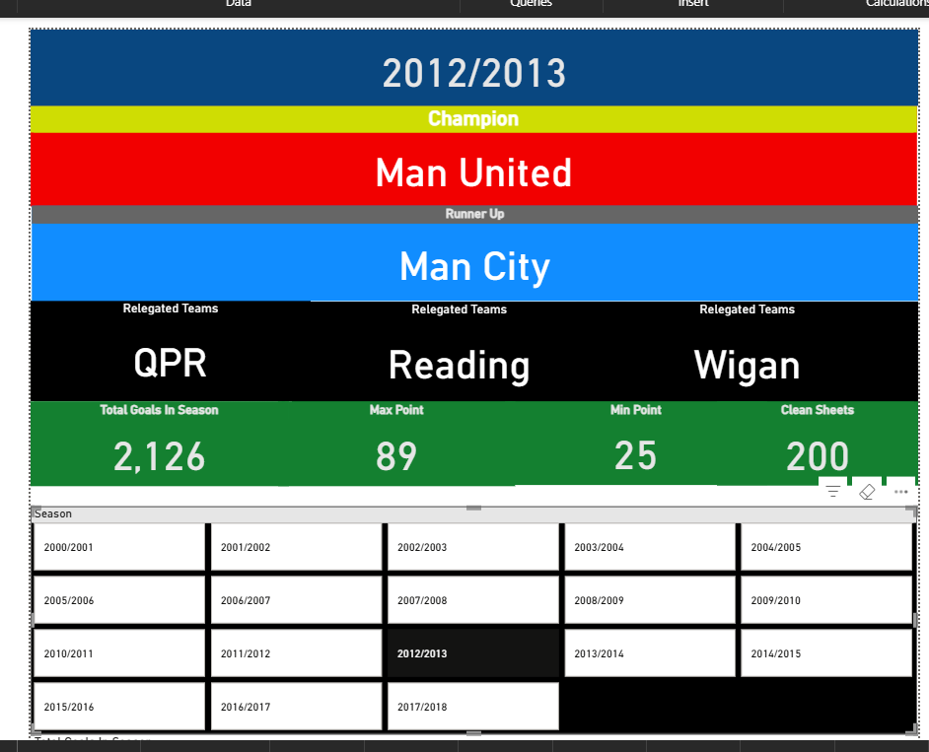
Dashboard 1 contains the statistics for all 18 seasons, with the option to analyze a selected season using a slicer. At the top of the dashboard, I included cards showing: - The team with the most points in all seasons and in the selected season. - The runner-up team. - The lowest three teams by points. - The total goals (for all seasons or the selected season). - The maximum and minimum points (for all seasons or the selected season). - The count of clean sheet

Slide 15
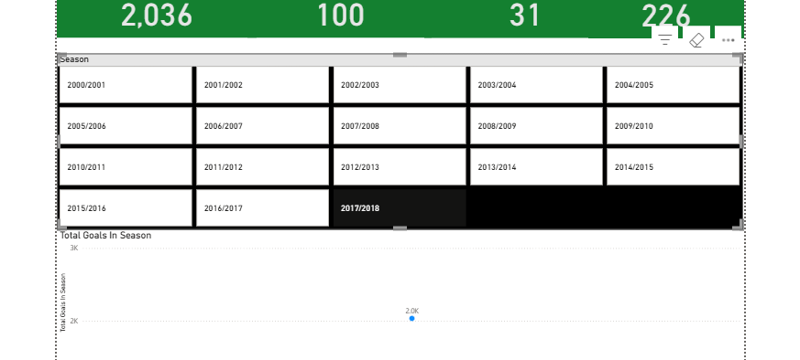
That slicer will work in all charts in dashboard 1 and it will make statistics for all charts on it depend on the season selected

Slide 16
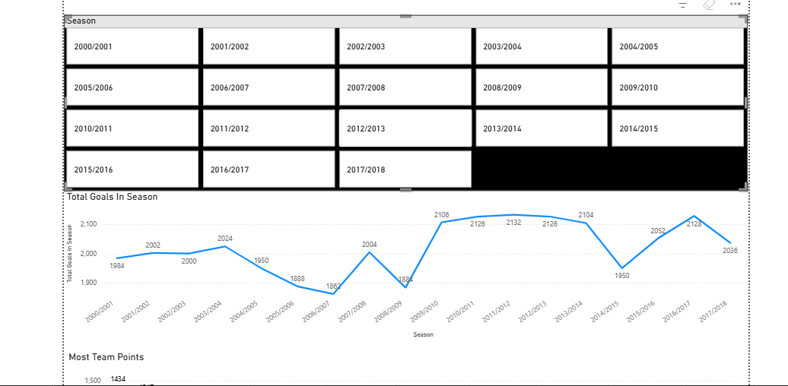
This chart is not interactive; it shows the season with the most goals scored

Slide 17
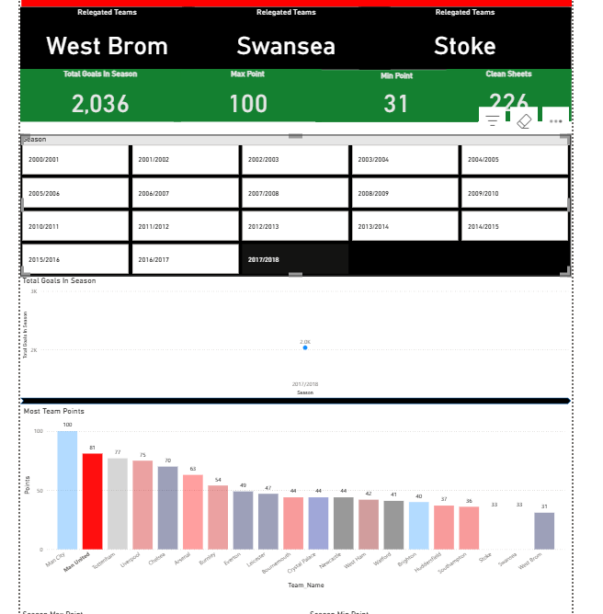
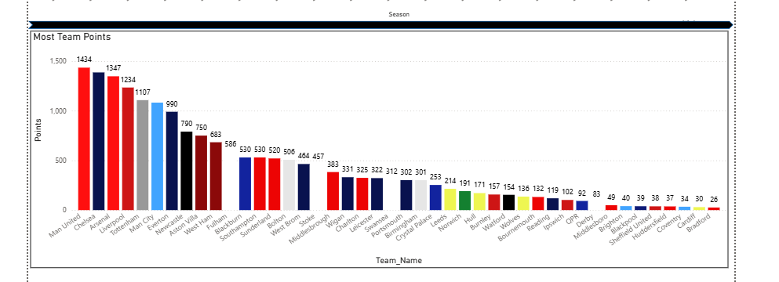
These charts show the team with the most points across all seasons, which is Manchester United. If a season is selected using the slicer, the charts display the Premier League table for that season based on points

Slide 18
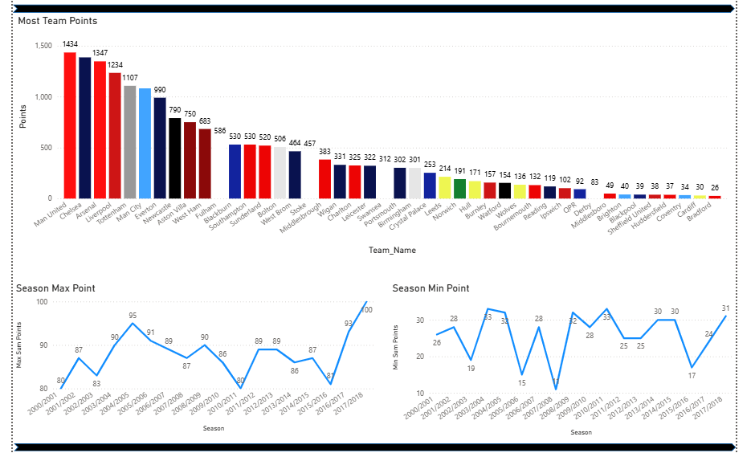
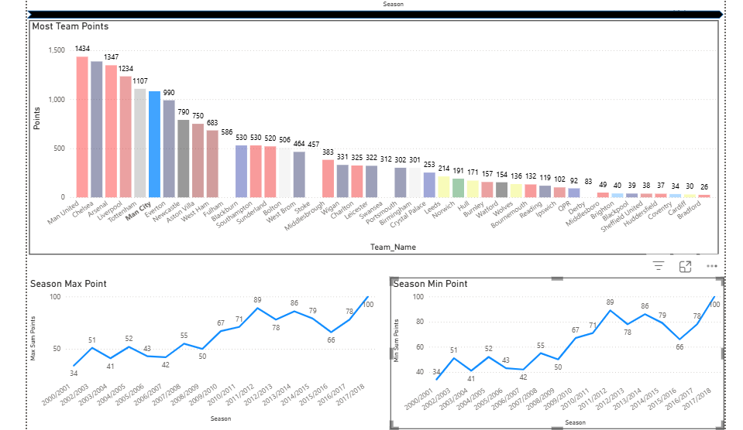
Then, I created two line charts showing the maximum and minimum points in each season. They are interactive by team name: if a team is selected, the charts display its points statistics for the seasons it played in the Premier League.

Slide 19
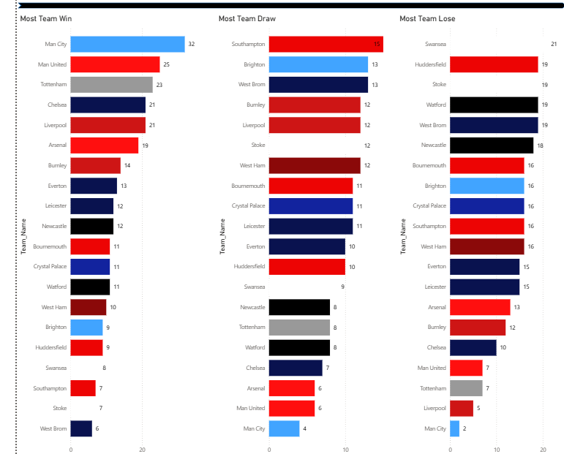
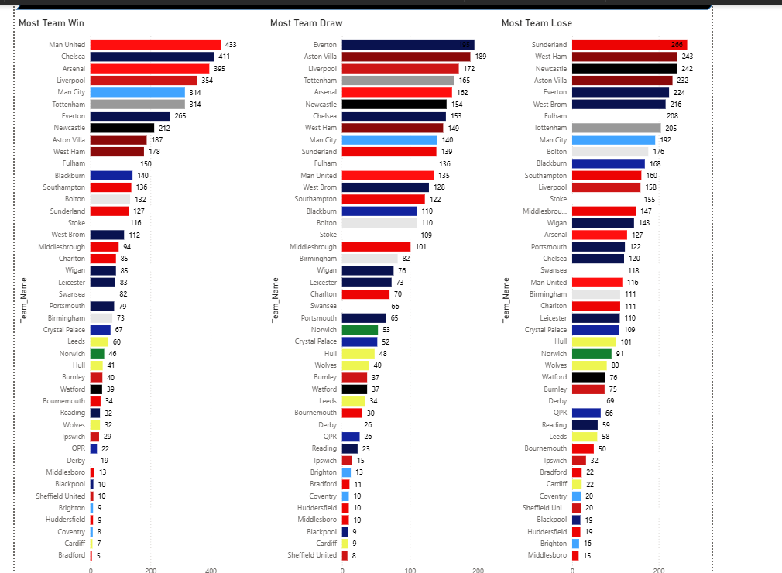
These charts shows the statistics of the teams with the most wins, losses, and draws, either across all seasons or for a selected season using the slicer.

Slide 20
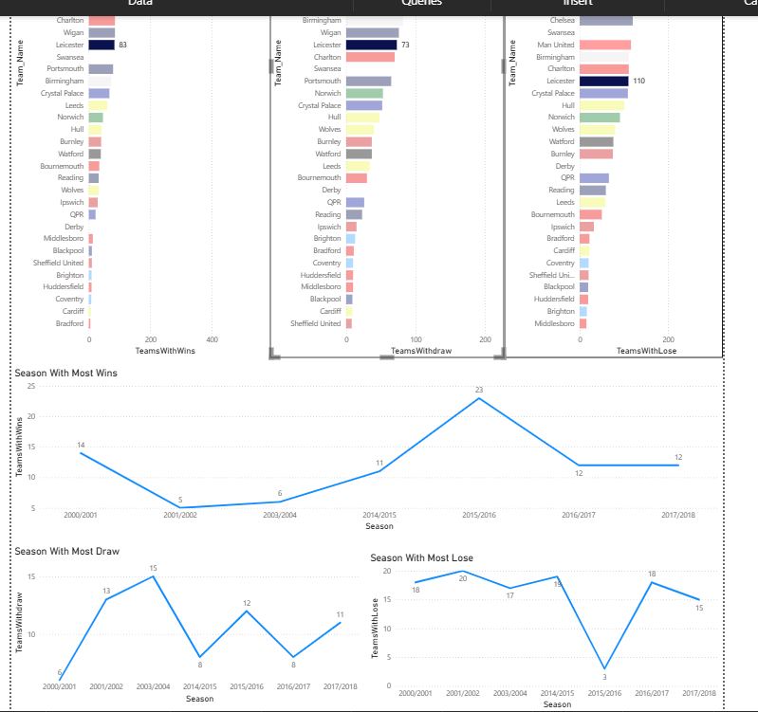
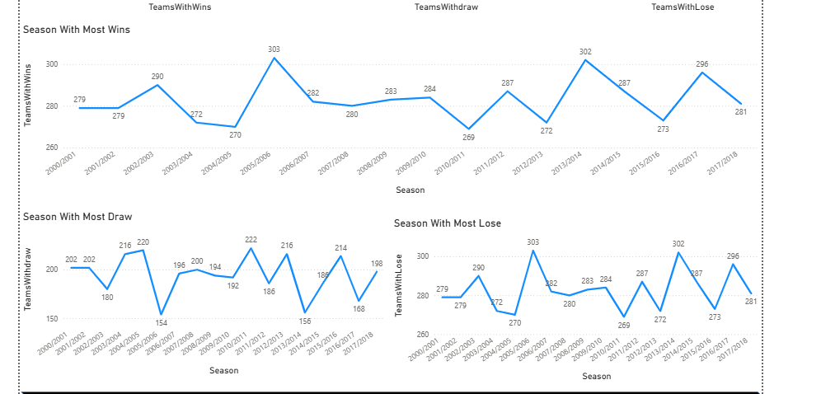
This Line chart show the seasons have most wins and draw and lose it is useful for teams if I select team it will show to me the win for team in all seasons and draw and lost.

Slide 21
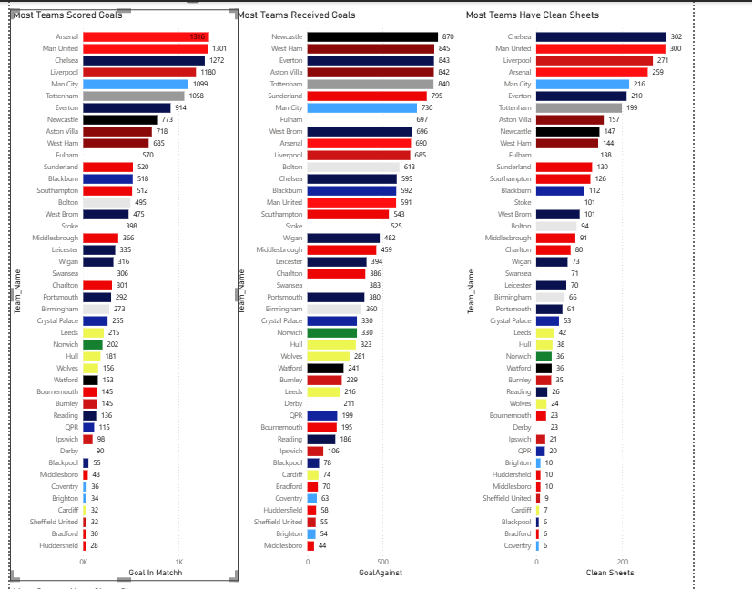
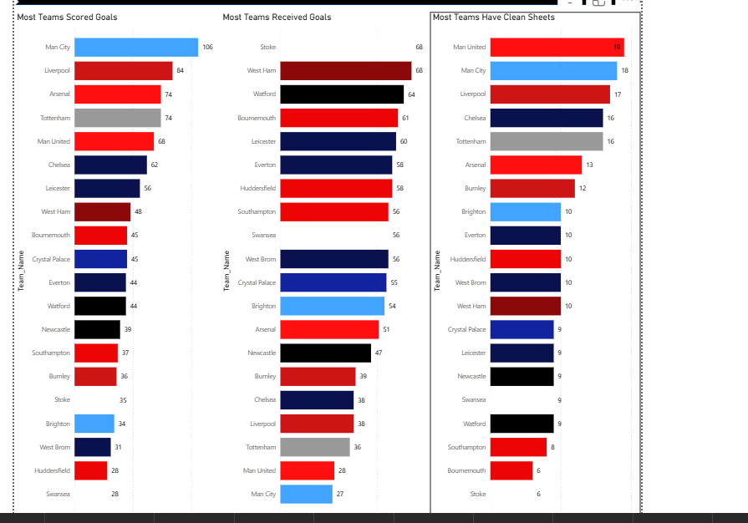
This bar chart show the most team scored and received and make clean sheet in all seasons or if we select from slicer

Slide 22
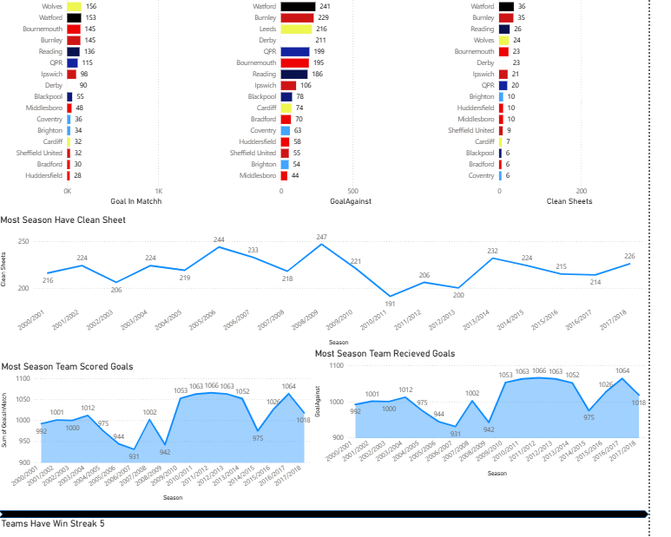
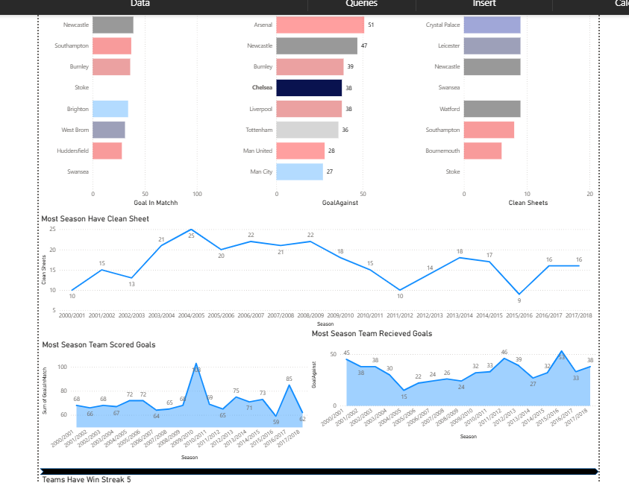
This line chart shows the seasons with the most clean sheets for the selected team. Another two area chart displays the goals scored and conceded by that team across all seasons

Slide 23
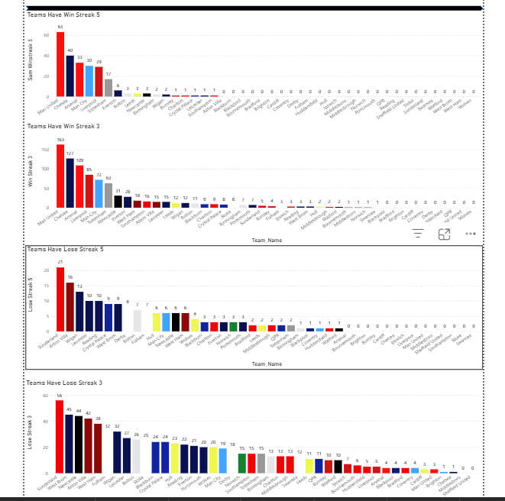
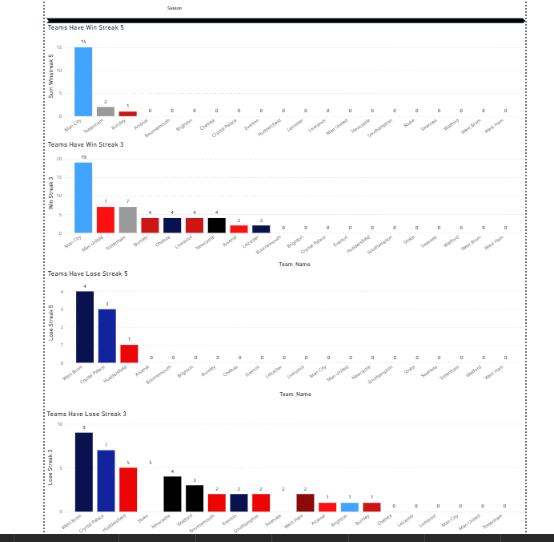
This chart is show the team have win streak 5 matches and 3 matches and lose streak 3 matches and 5 matches also for all season or selected season from slicer

Slide 24
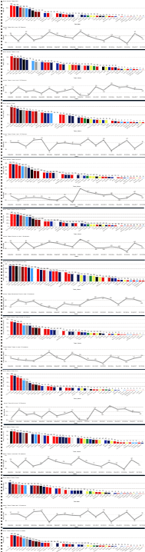
Dashboard 2

Slide 25
"Dashboard 2 is responsible for the statistics of teams at home and away. All charts in Dashboard 2 are interactive and synchronized with filters across the dashboard."

Slide 26
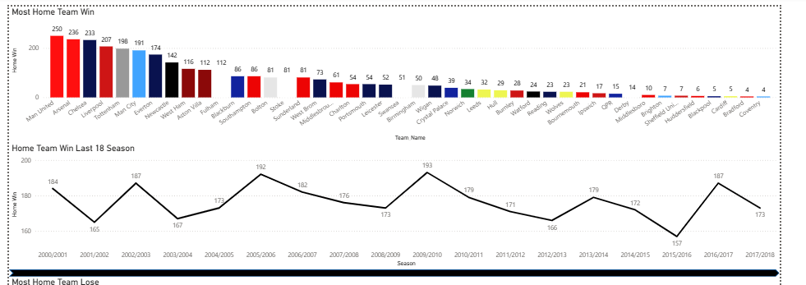
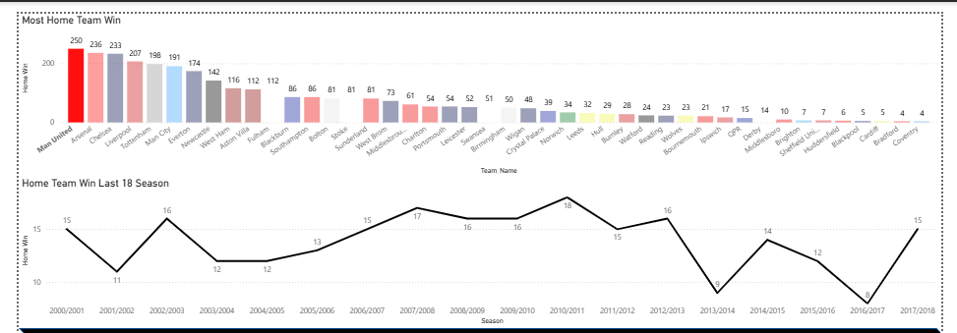
The first chart shows the teams with the most home wins. When selecting a team, it displays the total goals that team scored at home across all seasons. A line chart is also available to view the team’s goals by season.

Slide 27
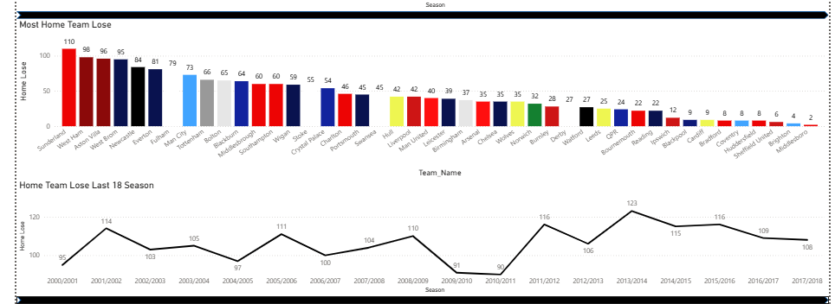
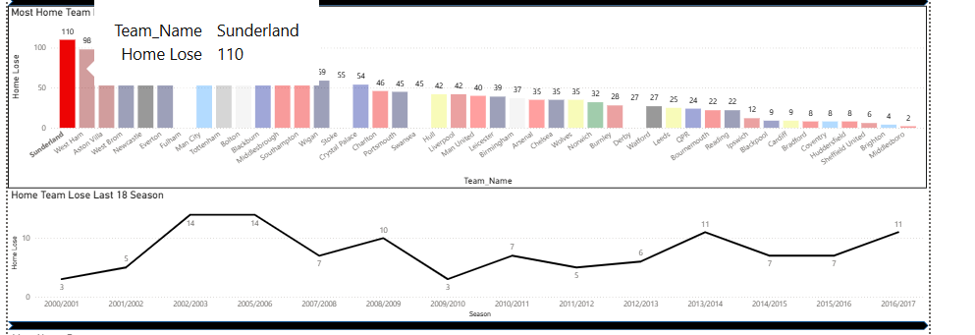
This chart shows the teams with the most home losses. By selecting a team from the column chart or a season from the line chart, it displays the seasons in which that team had the most home losses.

Slide 28
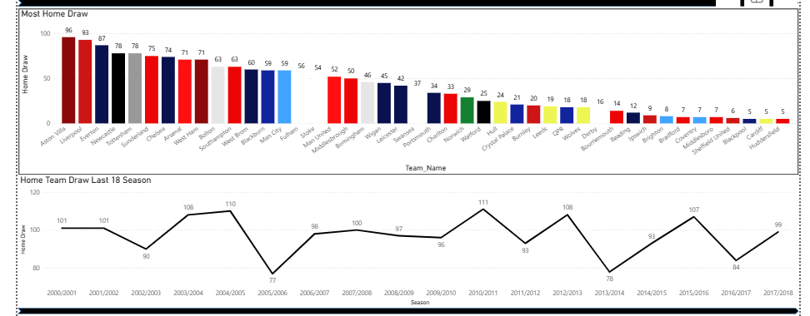
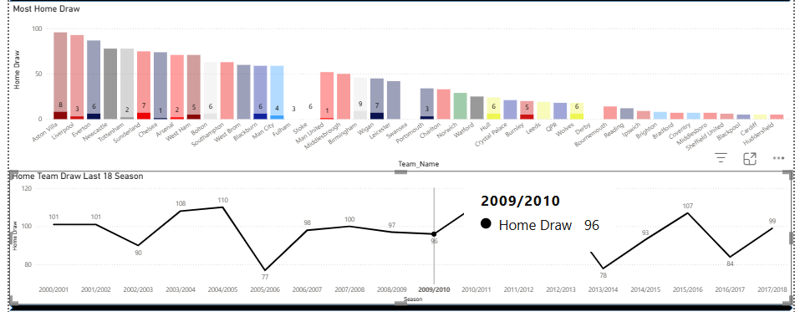
This chart shows the teams with the most home draws. When selecting a season or a team, the charts interact with each other.

Slide 29
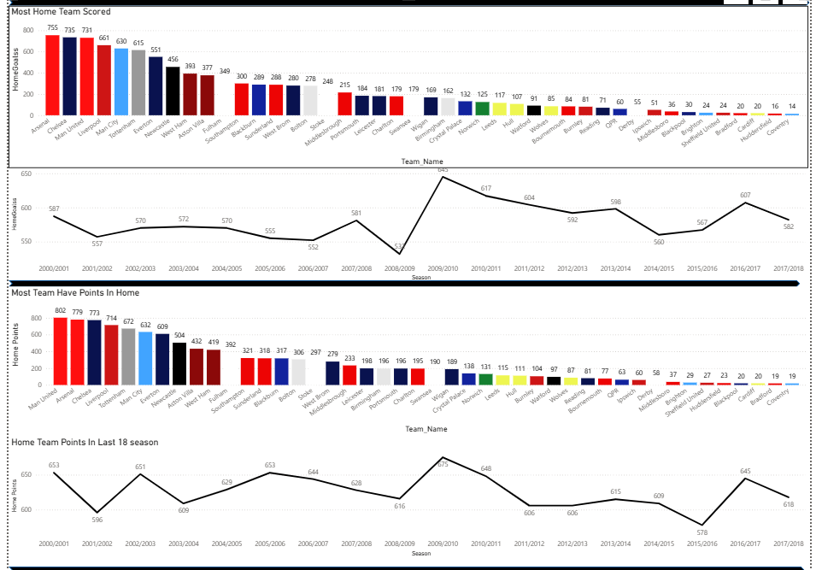
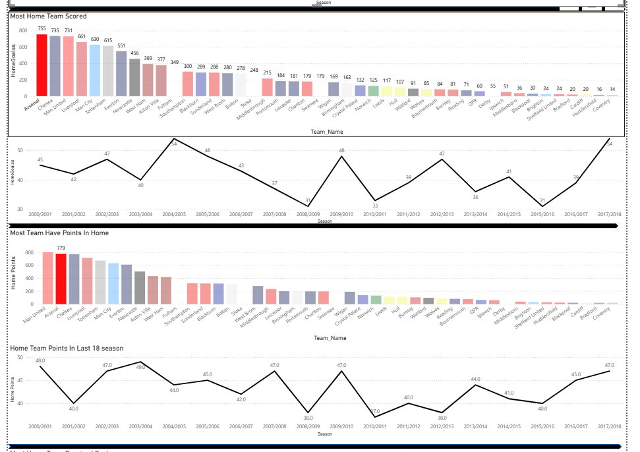
Those chart show the most team score in home and most team has points in home

Slide 30
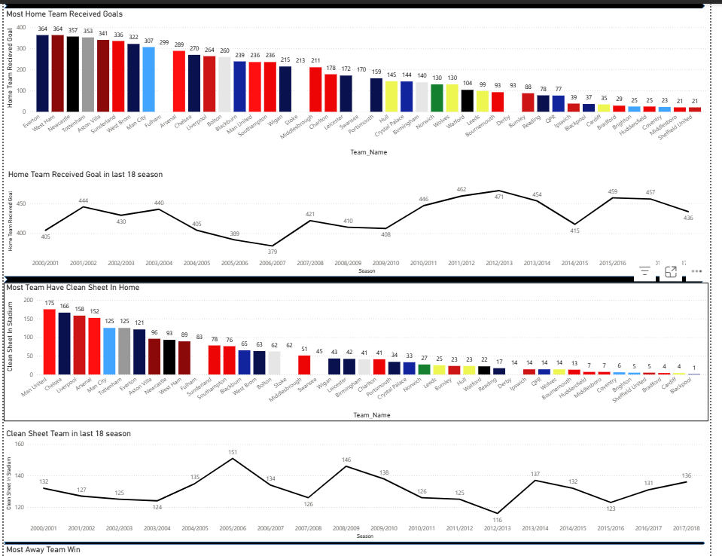
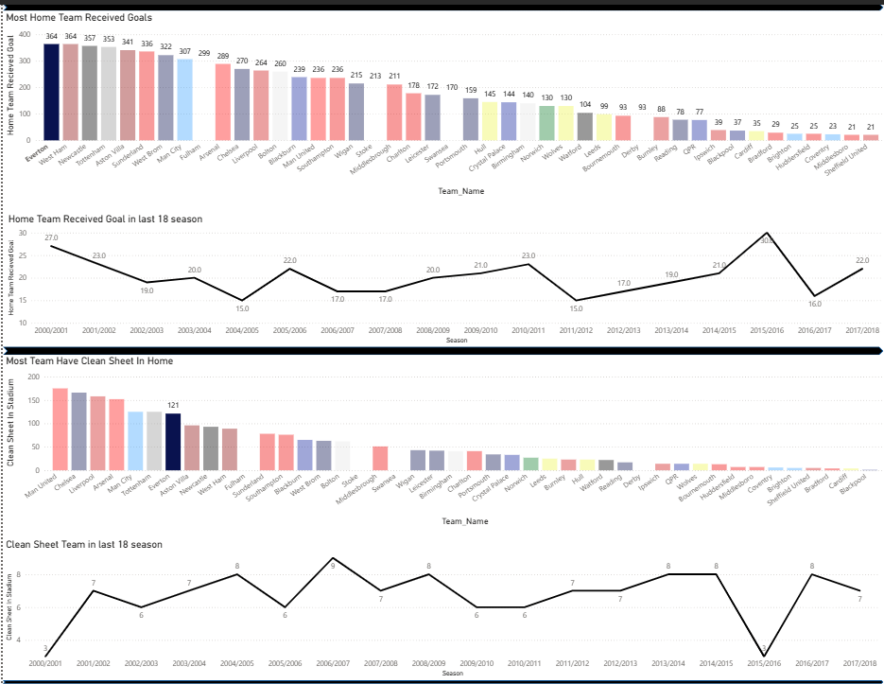
Those chart show the most team conceded goals in home and most team have clean sheet in home

Slide 31
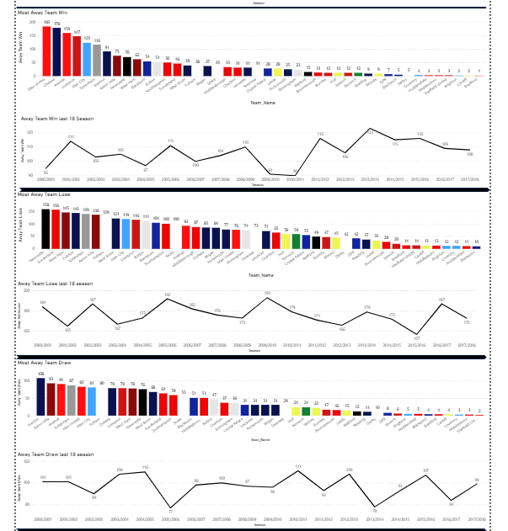
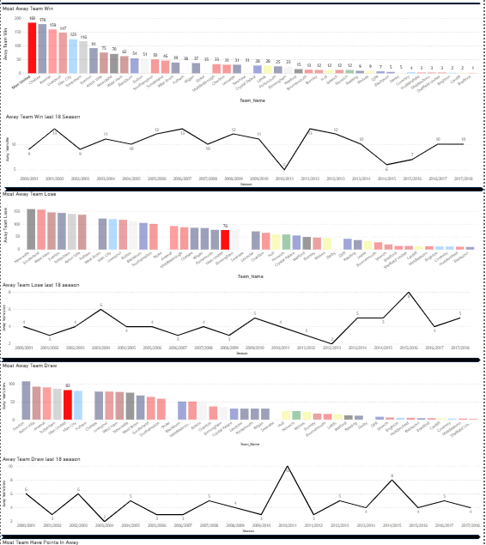
These charts show the most teams win ,lose ,draw in away matches

Slide 32
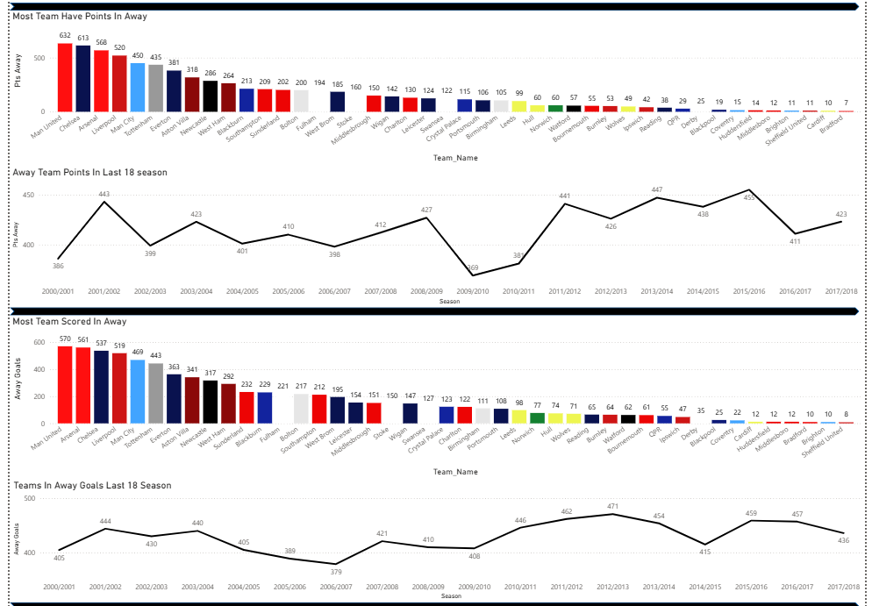
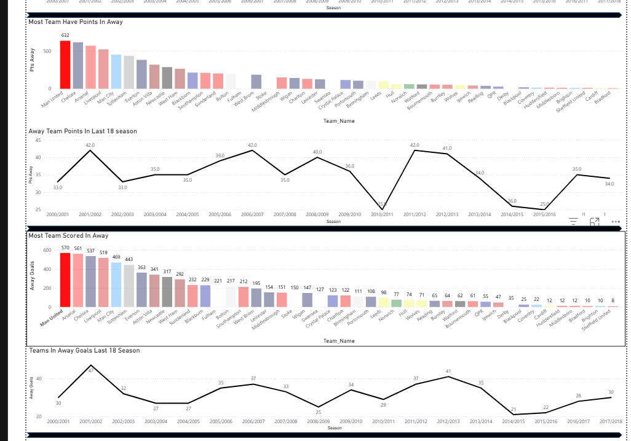
These chart show the most team take points in away and most teams scored goals in away

Slide 33
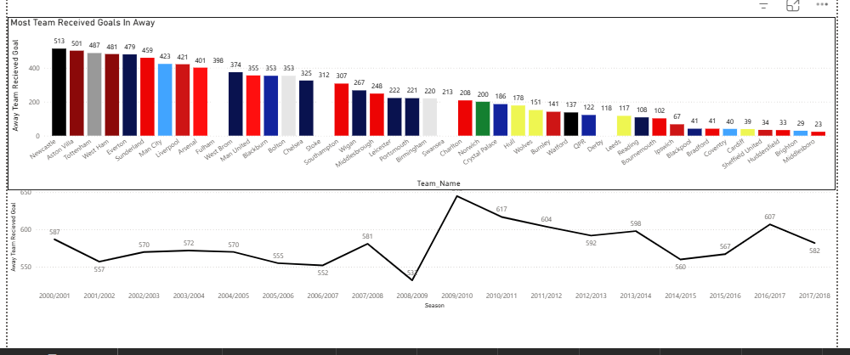
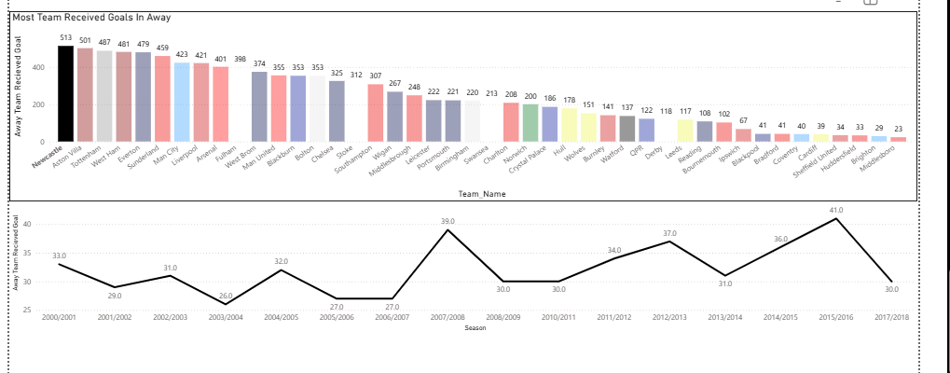
This chart show the most team conceded goal in away

Slide 34
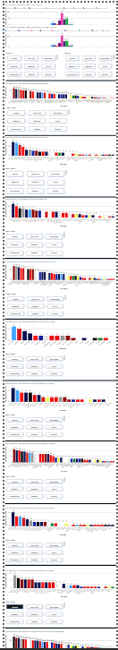
Dashboard 3

Slide 35
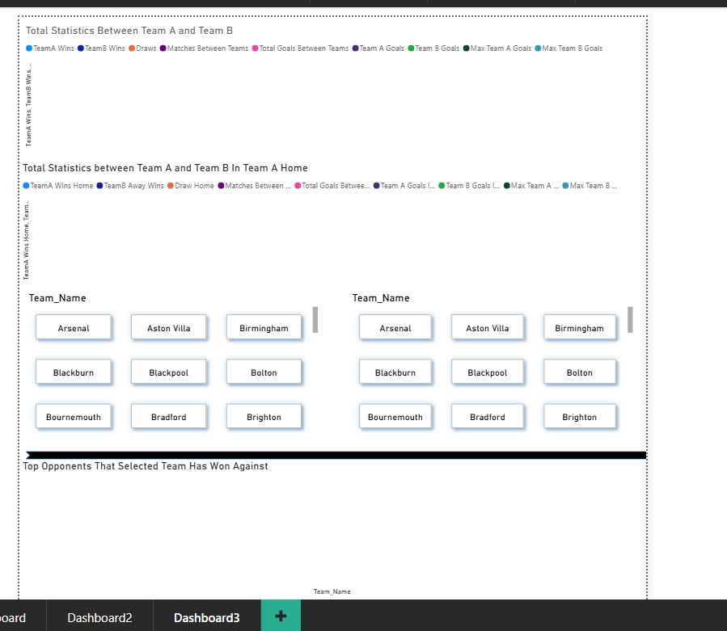
Dashboard 3 is responsible for showing matchups between teams. Each chart is controlled by its own slicer and does not interact with other charts.

Slide 36
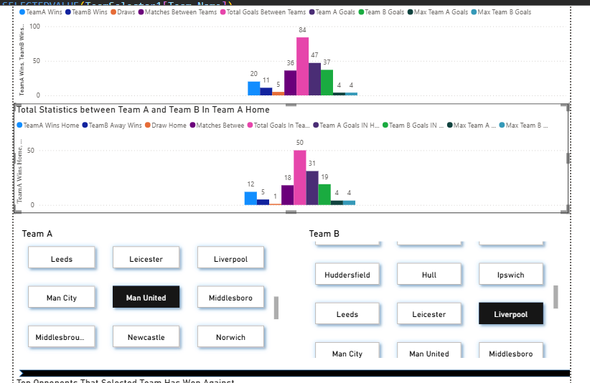
This chart works with two slicers: one for Team A and one for Team B. When selecting both teams, the chart shows: - How many times Team A has won against Team B and vice versa. - The number of draws. - Total matches played between the two teams. - Total goals scored by each team against the other. - Maximum goals scored by Team A against Team B and by Team B against Team A. The second chart shows the same statistics but only for matches where Team A played at home, including wins, losses, goals scored, and maximum goals in home matches

Slide 37
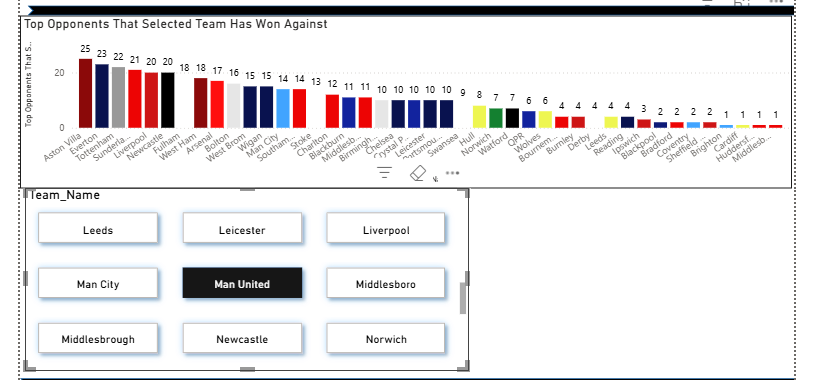
This chart shows the teams that Manchester United has beaten the most in all matches.

Slide 38
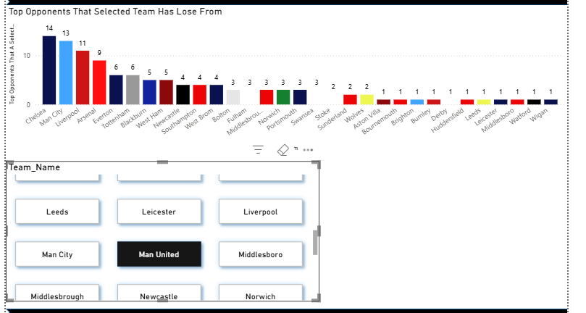
This chart shows the teams that Manchester United has lost to the most in all matches.

Slide 39

This chart shows the teams that Manchester United has drawn with in all matches.

Slide 40

This chart shows the teams that Manchester United wins against at home in all matches

Slide 41

This chart shows the teams that Manchester United loses to in home in all matches

Slide 42

This chart shows the teams that have drawn with Manchester United at home in all matches.

Slide 43

This chart show the most teams that man united win against in away

Slide 44

This chart show the most teams that man united lose to in away

Slide 45

This chart shows the teams that Manchester United has drawn with away.

Slide 46

This chart shows the teams that Manchester United has scored against in all matches.

Slide 47

This chart shows the teams that Manchester United has received goals from in all matches.

Slide 48

This chart shows the teams that Manchester United has scored goals against at home.

Slide 49

This chart show the most teams that man united Received goals from Home

Slide 50

This chart shows the teams that Manchester United has scored goals against away.

Slide 51

This chart show the most teams that man united Received goals from Away

Slide 52
This is all About Power Bi

Slide 53
SSAS Analysis

Slide 54

First, I selected the measures, dimensions, and my cube.

Slide 55
And then make my charts in excel with dashboard

Slide 56

This chart shows the season with the most goals, and it shows that the 2011/2012 season had the highest number of goals.

Slide 57

This chart shows the teams that received the most goals from the 2000/2001 season to the 2017/2018 season.

Slide 58

This chart works with a slicer to select a team and show the goals it scored and conceded in the 18 seasons.

Slide 59

This chart, like the previous one, also uses a slicer to show goals scored and goals conceded in the 18 seasons, along with the total points the team earned in each season.

Slide 60


These slicers show the most teams score in home and most team scores in away

Slide 61


These charts show the most team received goals in home and in away

Slide 62

This chart with slicer to select team to show the total goals the team scored home and away in each season

Slide 63


These charts also with slicer to show the total point for teams and total goals in all season

Slide 64
Conclusion
This project demonstrates the integration of multiple tools for data analysis and visualization. By combining Excel, SQL, SSIS, SSAS, and Power BI, it is possible to build a full end-to-end analytical solution, from data cleaning to reporting. The dashboards provide clear insights into team performances, trends across seasons, and comparative analyses, making it a useful tool for sports analytics.

